Slide 1

eCART
Spring Boot ecommerce application
Done By:
Syamchand Chilaka
Soundarya Seenappa
Guruvishnu Arunagiri
Chethana Badagi

Slide 2
CONTENTS
Customer Requirements
Problem Statement
Design/Architecture
Technologies Used
Screenshots

Slide 3
CUSTOMER REQUIREMENTS
Speed
Mobile Friendliness
Ease of use in the Checkout Flow
Personalization
Accessibility

Slide 4
PROBLEM STATEMENT
Create a Shopping cart application using Spring Boot with Hibernate/JPA.
Where User can login and order from cart.
Where Admin can edit the database.

Slide 5
ARCHITECTURE
REGISTER/
LOGIN
HOME
PRODUCT
ADD TO CART
CHECKOUT
PAYMENT
ORDER PLACED

Slide 6
TECHNOLOGIES USED
Spring Boot
Heidi SQL DataBase
Hibernate/JPA
Java
HTML
CSS
Java Script

Slide 7
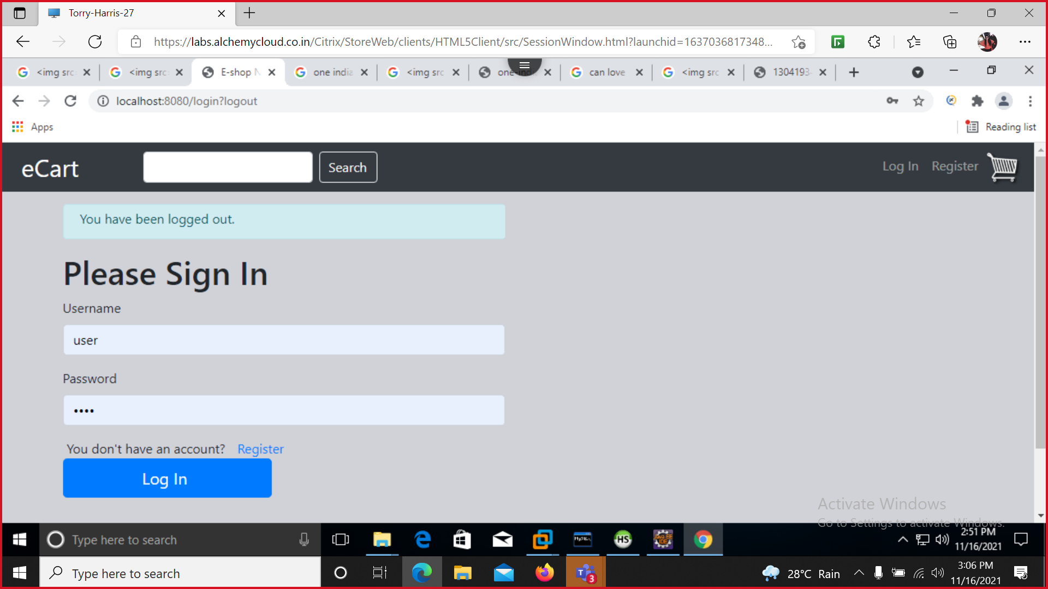
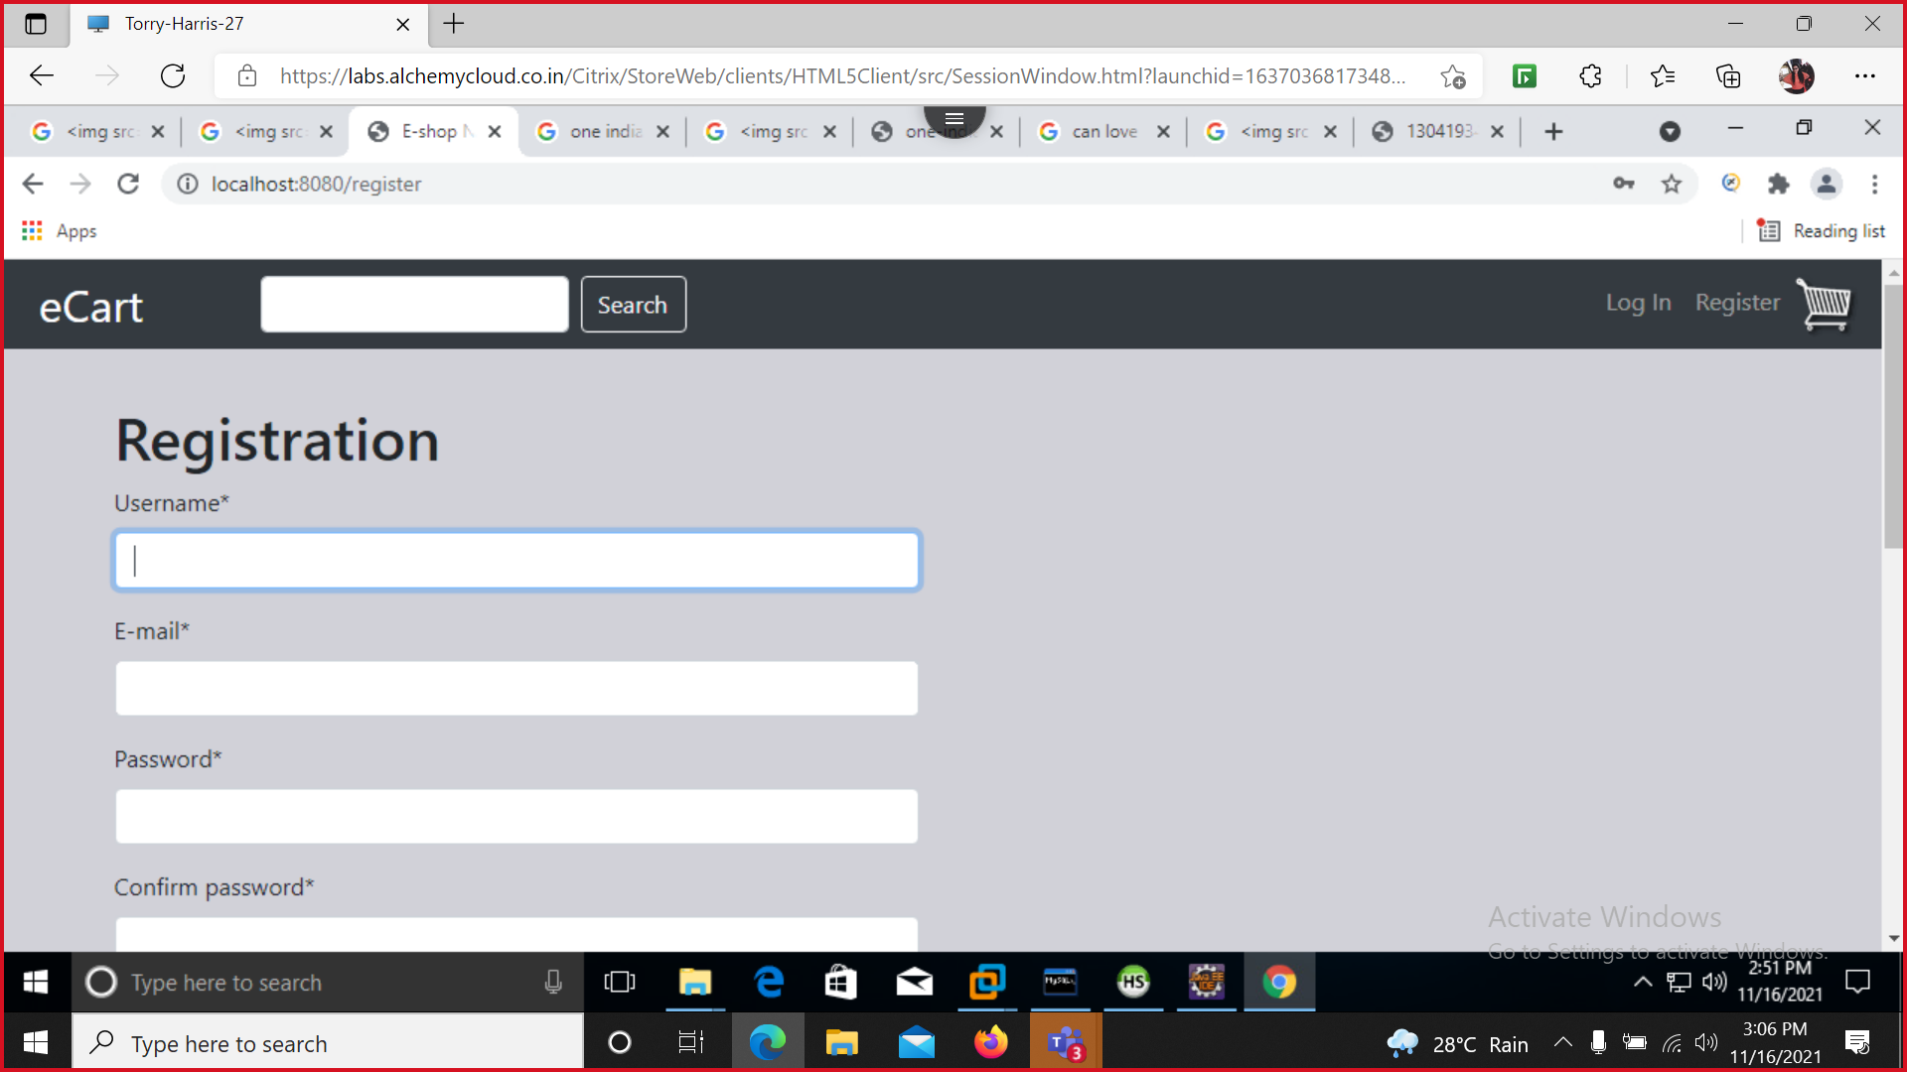
SCREENSHOTS

Slide 8
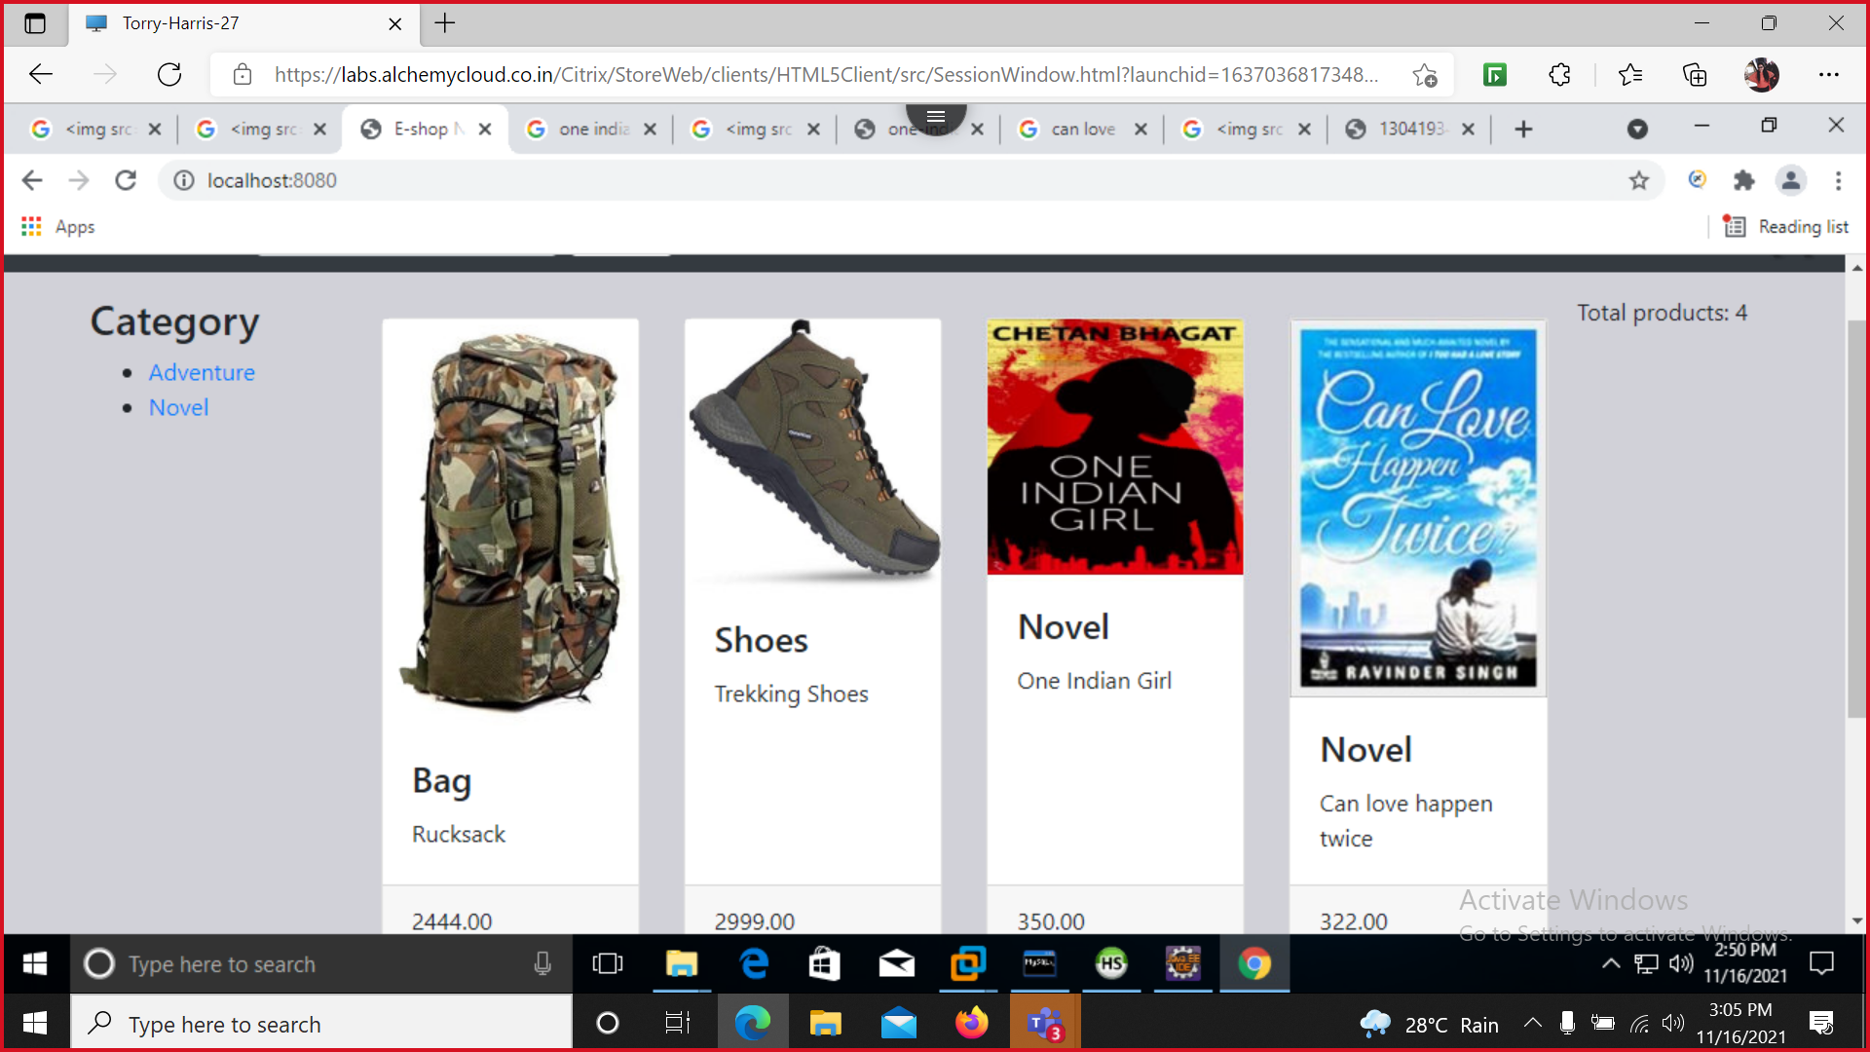
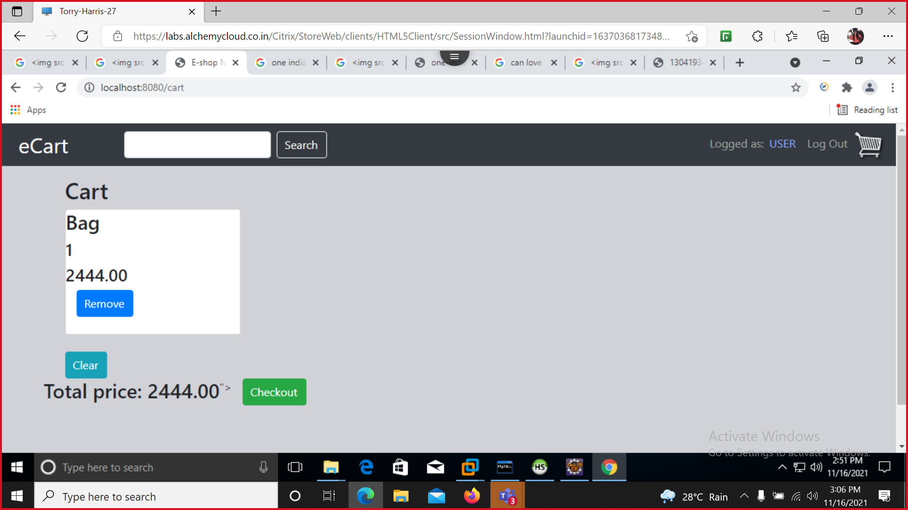
SCREENSHOTS

Slide 9



